Slide 1
CUSTOMER SERVICE WITHIN THE HIGH PERFORMING COURT FRAMEWORK:
Improving Courts’ Social Value
Presented by: Dr. Cyril W. Miller, Jr.
Department of Judicial Planning
Supreme Court of Virginia
Office of the Executive Secretary

Slide 2
OBJECTIVES
  Understanding the concept of a high performing court and its capitals
  Identifying employee engagement and the importance of utilizing teams as an integral part of the Clerk’s office
  Understanding the role customer service plays in the courts

Slide 3


OVERVIEW
  What is a high performing court and how does it
  improve the Court’s social value
Mission
& Visions
Capitals
Teamwork
Customers

Slide 7
THE FOUR MANAGEMENT CAPITALS of a High Performing Court
Organizational Capital
Organizing judges and staff to achieve the best use of time in pursuing common goals and communicating those goals clearly to justice system partners.
Technological Capital
Using technology to achieve greater efficiency and quality, while managing it competently. Implementing up-to-date technology in an integrated way is key to effectively managing court business processes.
Information Capital
Pursuing a credible evidence-based system to evaluate court performance. Ongoing attention to measurement and analysis help to ensure data are valid and meaningful.

Slide 8
THE FOUR MANAGEMENT CAPITALS of a High Performing Court, cont’d
HUMAN CAPITAL
Promoting the sharing of information and ideas on performance strategies, targets, and results. Input and feedback are solicited by court leaders from all personnel.

Slide 9
HUMAN CAPITAL
ENGAGEMENT

Slide 10
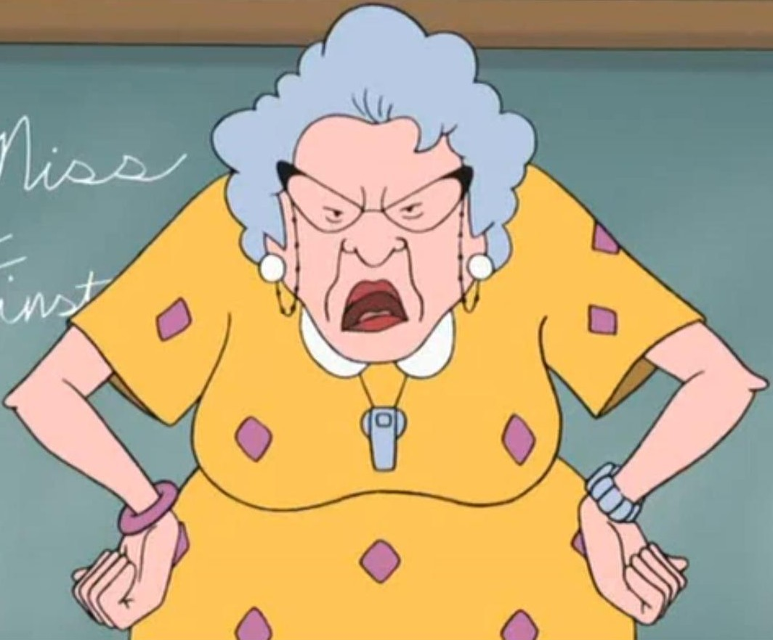
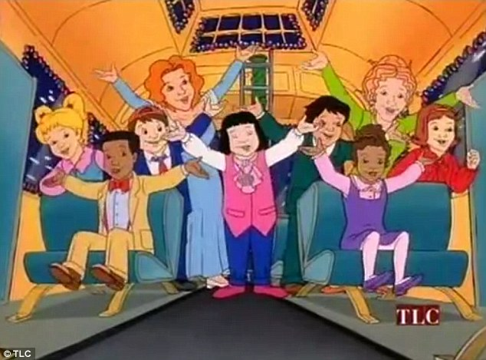
OLD SCHOOL vs. NEW SCHOOL
OLD SCHOOL
We treat everyone fairly & consistently.
NEW SCHOOL
We treat people as individuals.

Slide 11
HIGH PERFORMING CULTURES
Leaders create higher levels of employee engagement.
Leaders create an environment that supports productivity and performance.
The employee feels enabled and energized.
Focus on customers.
Create a sense of transparency.
Communicate with management and each other.
Appreciation and camaraderie.
Hold employees accountable.

Slide 12
What is employee engagement?
The employee has a sense of purpose that is evident in their display of dedication, persistence and effort in their work or their attachment to the mission and visions of the courts. They are willing to go the extra mile.

Slide 14
EMPLOYEE EXPERIENCE: Old Rules vs New Rules
Old Rules | New Rules
Employee experience defined by annual engagement surveys | Employee experience defined as a holistic view of life at work, requiring constant feedback, action, and monitoring
Culture is a topic on the court website and perhaps on the wall, but not measured or defined through behavior | Court uses tools and behaviors to measure, align, and improve culture during change, M&A, and other major initiatives
Courts have a series of HR leaders across recruiting, learning, rewards, engagement, and other HR services | Courts have someone responsible for the complete employee experience, focused on employee journeys, experiences, engagement, and culture
Compensation, benefits, and rewards are managed with a focus on benchmarking and fairness | Compensation, benefits, rewards, and recognition designed to make people’s life better and balance financial and nonfinancial benefits
Wellness and health programs are focused on safety and managing insurance costs | Courts have an integrated program for employee well-being focused on the employee, her family, and her entire experience at life and work
Rewards are designed to cover salary, overtime, bonus, benefits, and stock options | Rewards also include nonfinancial rewards: meals, leaves, vacation policy, fitness, and wellness programs
Employee self-service is viewed as a technology platform that makes it easy to complete HR transactions and reports | The employee experience platform is designed, mobile, and includes, digital apps, prescriptive solutions based on employee journeys, and ongoing communications that support and inspire employees
Adapted from Deloitte University Press|dupress.deloitte.com

Slide 15


ARE YOU A TOXIC BOSS?
You find yourself frustrated when you have to coach an employee on a skill.
You feel you must double-check every employee’s work.
You have no desire to know anything about your employees other than whether they’re doing their job right.
You feel constantly behind and split in too many directions.
You’d rather stay in your office than converse with your team.
You feel your employees’ career growth should be their concern, not yours.
You can’t plan for the growth of the department because you can’t imagine ever hitting your existing goals with your current team.
You hate that some of your staff have skills that force you to depend on them, because you don’t have those skills yourself.

Slide 16
WHAT MAKES A MANAGER GREAT?
Is a good coach.
Empowers team and does not micromanage.
Creates an inclusive team environment, showing concern for success and well-being.
Is productive and results-oriented.
Is a good communicator—listens and shares information.
Supports career development and discusses performance.
Has a clear vision/strategy for the team.
Has key technical skills to help advise the team.
Is a strong decision maker.

Slide 17
What is the neuroscience of engagement?
We are neurologically wired to minimize danger and maximize reward.
Whenever we are working and interacting with others our reward or threat responses can be activated.

Slide 18
How does an engaged employee impact the Courts?
David Rock, director of the NeuroLeadership Institute believes that the reward or threat response is activated by five key drivers – status, certainty, autonomy, relatedness and fairness, “SCARF.” Rock notes that a threat to any one of these drivers activates our threat response, hence the disengaged employee.
http://www.bakerbrand.com/neuroscience-of-employee-engagement/

Slide 19
How does an engaged employee impact the Courts? cont’d
Therefore, leaders can expect great things when the reward systems of their employees are activated. Engaged employees are capable of more creative problem solving. They come up with fresh solutions to streamline customer service. An engaged employee moves the court into becoming a High Performing Court.

Slide 20

THREE WAYS TO UNLOCK ENGAGEMENT
Understand Motivators
Develop Your People
Praise Effort, Reward Results

Slide 21
Can employees be placed in a position within a Clerk’s Office that better suits their personality?
PERSONALITY
Who we are
STRENGTHS
What we are good at
MOTIVATORS
What our passions are

Slide 22
So how do we unlock an employee’s potential?
Employees do not check their personalities at the door when they come to work.
Each person’s potential extends well beyond his or her job description. Tapping that potential means recognizing how an employee’s unique set of beliefs, talents, goals and life experiences drives his or her performance, personal success, and well-being.
Each employee is different and all the employees in your office are going to have different motivators.
Helping the employees understand the impact they make to the organization could help about two-thirds of the employees become more engaged. So let’s look at the motivators and a look at the next generation of workers, the Millennials!

Slide 23
MOTIVATORS
Autonomy Friendship Problem Solving
Challenge Fun Purpose
Creativity Impact Recognition
Developing Others Learning Service
Empathy Money Social Responsibility
Excelling Ownership Teamwork
Excitement Pressure Variety
Family Prestige

Slide 24
By 2024 professional services giant Deloitte estimates about 75 percent of the worldwide workforce will be Millennials. That presents challenges for some managers who remain unaware of the unique nature of this rising generation.
There are inherent risks in generalizing an entire generation of people.
The average Millennial tends to job-hop every two to three years. Great leaders are beginning to understand what will keep their Millennials engaged in greater numbers.

Slide 25
The five most motivating work concepts for Millennials are:
A. Impact 64%
B. Learning 62%
C. Family 51%
D. Creativity 40%
E. Challenge 38%
Other drivers that emerged with Millennials in greater frequency than with older generations included Friendship, Fun, Recognition, Service and Empathy.

Slide 26
Some of the least motivating work concepts for Millennials included:
A. Autonomy 20%
B. Ownership 17%
C. Money 9%
It is therefore important to assess each employee’s motivators on an individual level and sculpt their jobs around those motivators that engage employees and do fewer activities that demotivate them. This goes for all employees, not just the Millennials!

Slide 27
MEASURING EMPLOYEE ENGAGEMENT
When an employee can make the following statements with confidence, they are much more likely to be engaged.
PROFESSIONAL GROWTH - This past year, I have been given many opportunities to learn and grow, both professionally and personally.
My manager regularly discusses my performance and progress with me and asks if there is anything else he can do to make my job easier.
TEAM ORIENTATION – I believe my fellow team members are engaged and want to do great work.
I am clear on the mission and purpose of this organization and know how my work impacts mission success.
INDIVIDUAL NEEDS – I know what is expected of me in this role.
I have the training and resources to excel at my job.
I receive both recognition and constructive guidance.
My manager cares about me as a person.

Slide 28
HUMAN
CAPITAL
ENGAGEMENT
TEAMWORK

Slide 29
TEAMWORK SKILLS
“Individual commitment to a group effort – that is what makes a team work, a company work, a society work, a civilization work.” – Vince Lombardi
Employers expect employees to be team players even if it seems like a job is best suited to an individual worker.
You may perform the bulk of your work alone, but you still have to be able to think of your work in the context of the Clerk’s Office as a whole and the larger goals of the Judiciary.
You must be able to work well with others and you need to be able to communicate your accomplishments to other people in your office.
Teamwork takes individual work for a collective good that ultimately increases the good everyone receives.

Slide 30
SEVEN TEAMWORK SKILLS
Communication – a good team member communicates their ideas to the group. You must be able to convey information via phone, e-mail and in person. You want to make sure your tone is always professional but friendly. Both verbal and nonverbal communication is important when working with a group. When there are problems or successes a team has to be willing to communicate effectively what went right or wrong.
Listening – There is a time to talk and a time to listen. The time to listen comes twice as often as the time to talk.
Sharing – What one person knows may be the key to another person’s problem. You have to be willing to share those keys even when it will make someone else look better.

Slide 31
SEVEN TEAMWORK SKILLS, cont’d
Language – It is so important that you have an established habit of speaking in an uplifting way. If you are at all demeaning or domineering or insulting it will grind the team to a halt.
Hard work – team members have to be willing to work hard on an individual basis and then turn that work over to the team so that as a whole you can make your work meaningful and achieve a greater goal.
Persuade – Everyone should be encouraged to exchange, defend and then eventually rethink their ideas.
Helping – Offering help and actually following through with real assistance is an important part of being a team. If you suspect a team member is struggling with something, your offer to help makes a difference. When we offer to help, we share their burden.

Slide 32
HUMAN CAPITAL
ENGAGEMENT
TEAM
WORK
CUSTOMER SERVICE

Slide 33
CUSTOMER SERVICE
Customer service should be termed as “being of service” to the customer.
Customer service is about meeting and exceeding the expectations of the customer.
Customers expect those assisting them to be extremely helpful, positive and informative. It is an integral part of the job in a Clerk’s Office and should not be seen as an external extension of it.
The things most important to the customer is effective listening and undivided attention.

Slide 34
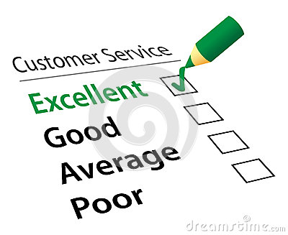
CUSTOMER SERVICE SKILLS
Understand the customer
First impressions are real and lasting
Do what you say you are going to do
UNDER promise and OVER deliver
Listen to your customer
The little things matter
If a mistake is made, own it

Slide 35

CUSTOMER SERVICE SKILLS, cont’d
Body language is key
Patience
Clear communication skills
Knowledge of the services you render
Time management skills

Slide 36
CONCLUSION
SO: HPCF = HUMAN CAPITAL
EMPLOYMENT ENGAGEMENT
CUSTOMER SERVICE
NOW ON TO DISTRICT COURT STAFFING!!

Slide 37
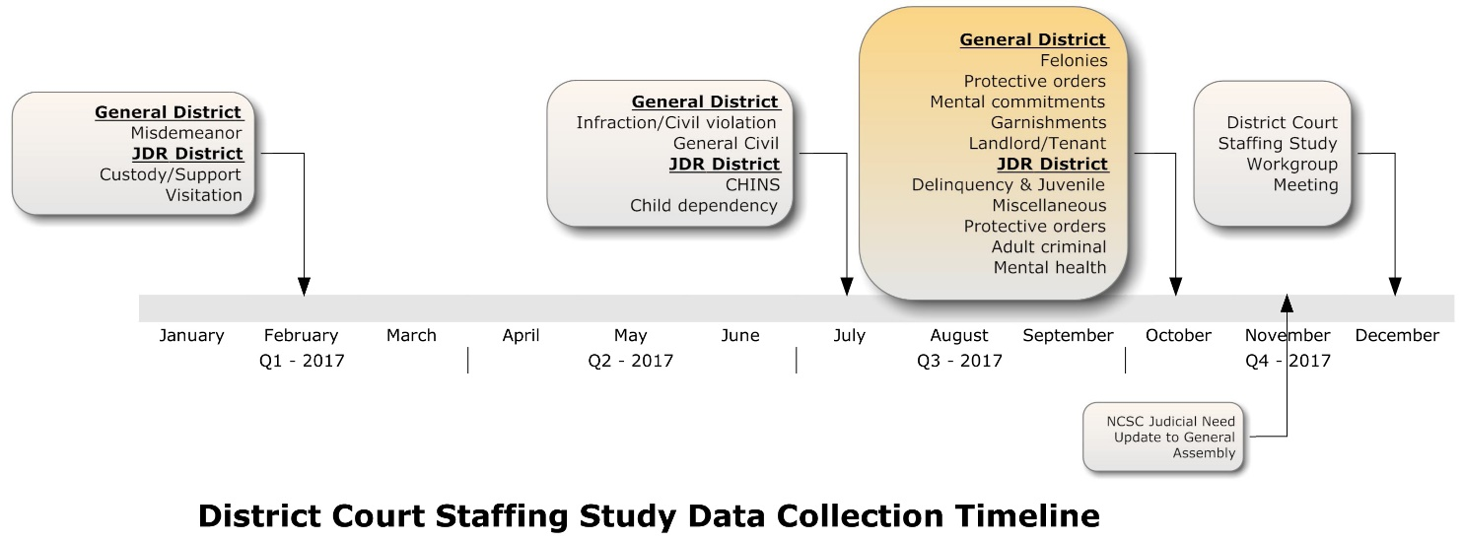
DISTRICT COURT STAFFING
District Court Staffing Workgroup Meeting Dates:
November, 2016
June, 2017
August, 2017
December, 2017

Slide 38
DISTRICT COURT STAFFING cont’d
Model Overview

Slide 39
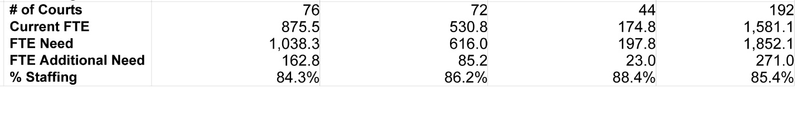
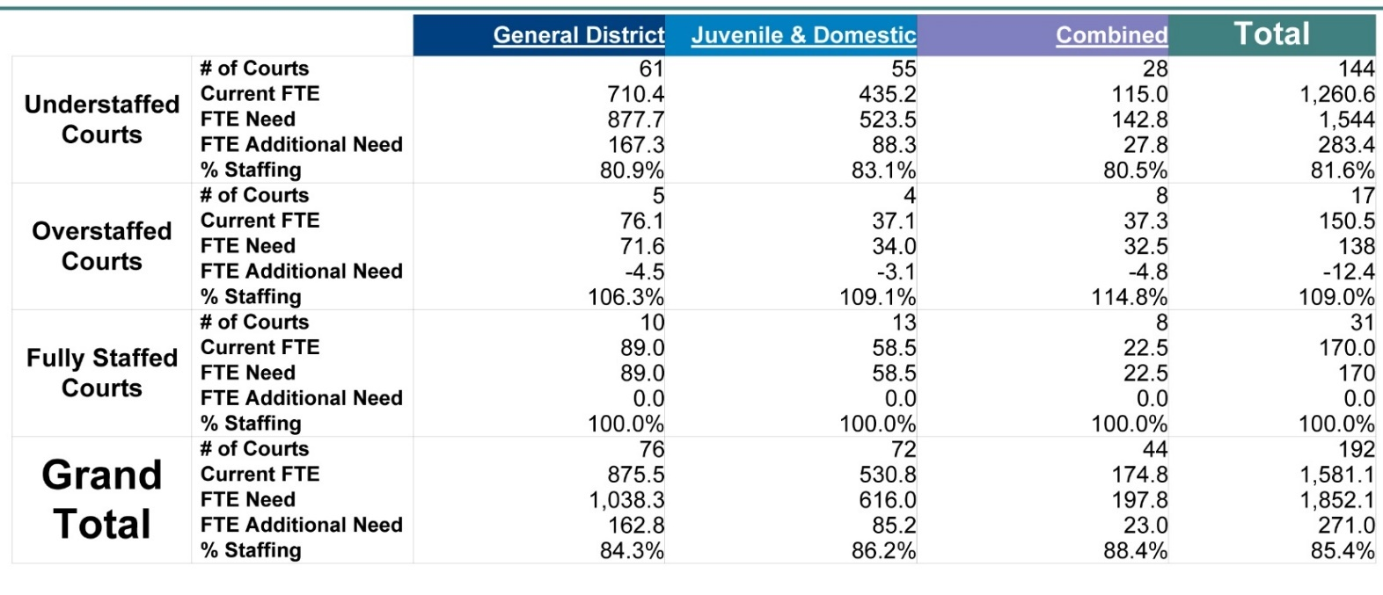
DISTRICT COURT STAFFING cont’d
Clerk’s Offices = 195

Slide 40
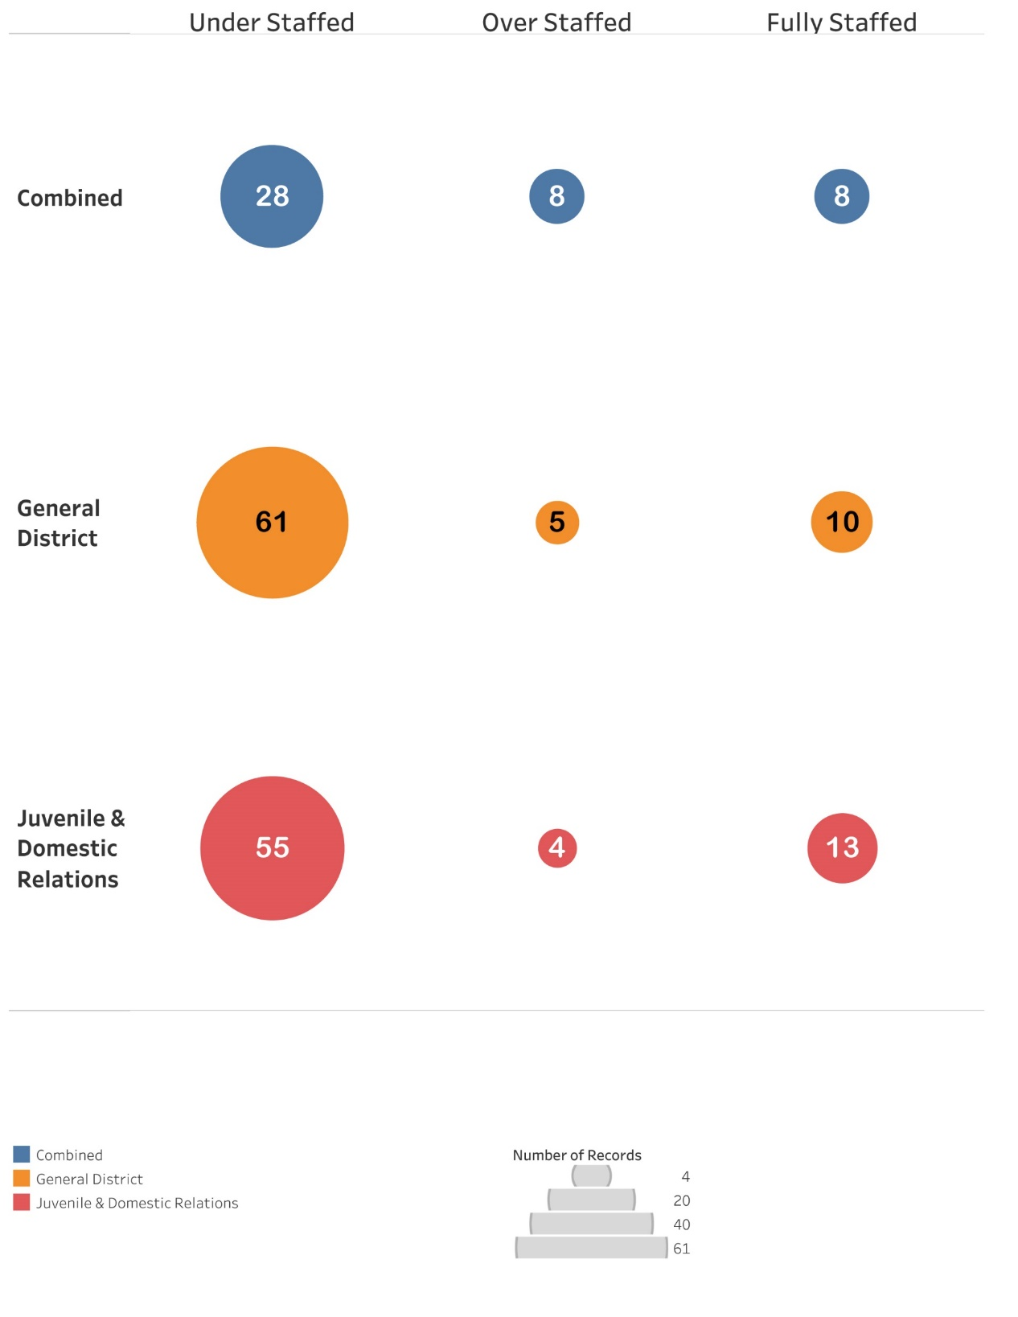
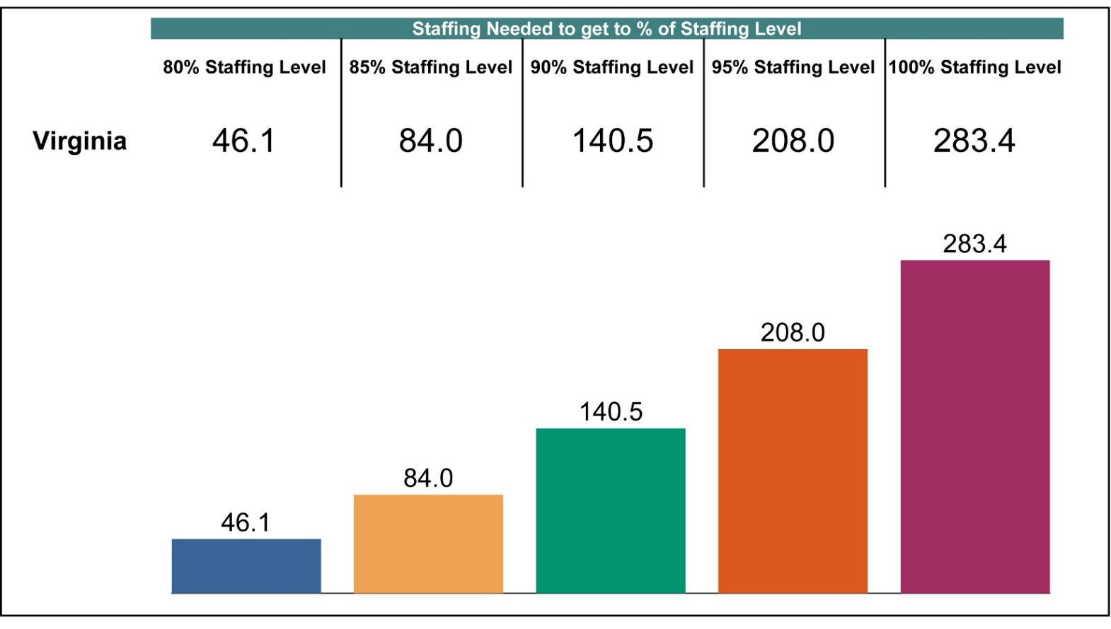
DISTRICT COURT STAFFING cont’d

Slide 41
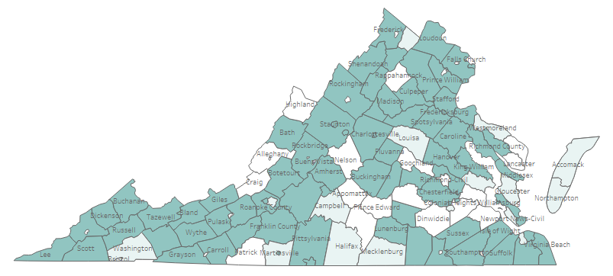
DISTRICT COURT STAFFING cont’d
Understaffed

Slide 42
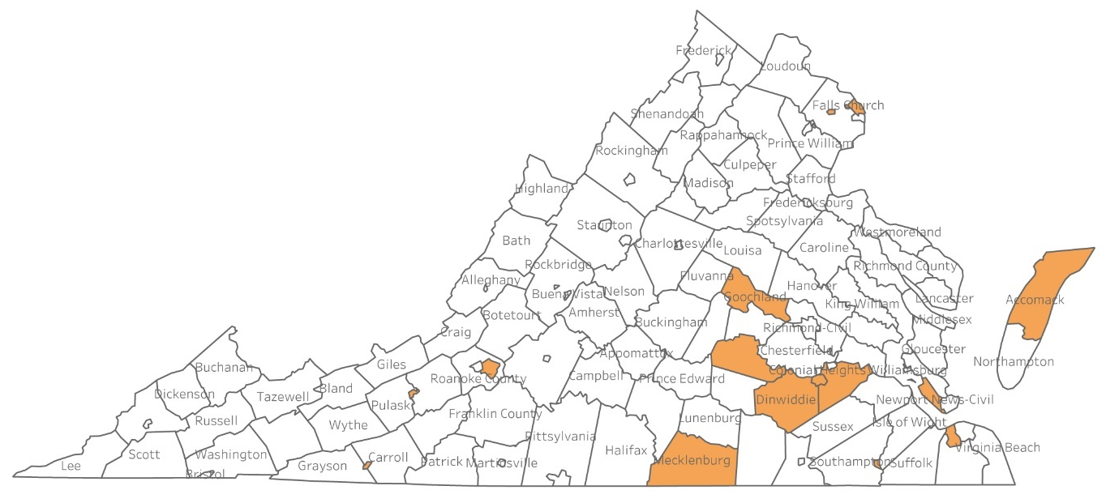
DISTRICT COURT STAFFING cont’d
Overstaffed

Slide 43
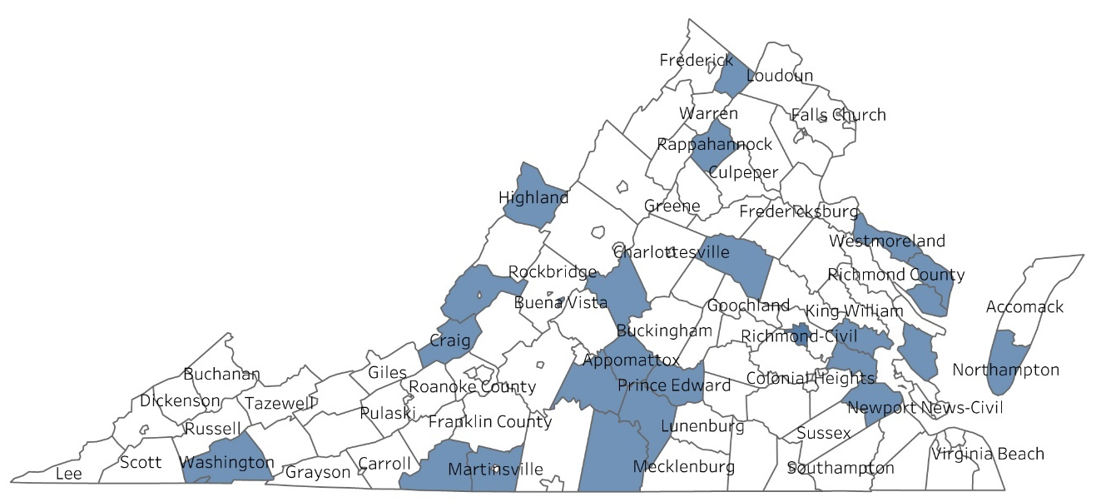
DISTRICT COURT STAFFING cont’d
Fully Staffed

Slide 44
DEPARTMENT OF JUDICIAL PLANNING SPRING 2018 MANAGEMENT INFORMATION WORKSHOPS
Dates Times Locations
05/23/18 10 – 1 Portsmouth GD Court Conference Room
05/24/18 11:15 – 2:15 Williamsburg/James City County Courthouse
Jury Assembly Room
05/25/18 10 – 1 Chesterfield J&DR Courthouse – Attorney/Police Lounge
05/30/18 10 – 1 Fredericksburg Police Department – Conference Room
05/31/18 10 – 1 Verona/Augusta Meeting Center – Smith’s Transfer Room, West
06/05/18 11 – 2 Salem Police Department – Conference Room
06/20/18 10 – 1 Wytheville Meeting Center
06/21/18 10 – 1 Virginia Highlands Community College, Abingdon,
Nursing Education Building – Conference Room
06/22/18 10 – 1 Danville Science Center
Court Performance Reports Update
Staffing Model Court Level Review

Slide 45
THANK YOU!
THE END!
For help contact:
Amanda Johnson 804-371-0155
Chris Wade 804-786-3320
To schedule Customer Service Training for your Clerk’s Office contact:
Susan Newman 804-786-8902

