Slide 1
DMV Overview
Florence Jett
Deputy Director, Driver Services
April 4, 2017

Slide 2
Objective
Provide 2017 legislative overview
Review:
Select restricted license orders
ASAP revokes vs revoked restricted license
DMV Administrative Requirements

Slide 3
Legislative Overview

Slide 4
HB 2051/SB 1091 Deferred Disposition for Possession of Marijuana
Removes the requirement that DMV administratively revoke for 6 months
Provides the court the discretion to suspend or revoke if the §18.2-250.1 offense did not occur in a motor vehicle
If the court does not suspend:
the court must require additional hours of community service
The court should not transmit the Deferred Disposition to DMV

Slide 5
HB 2051/ SB1091 Deferred Disposition for Possession of Marijuana Continued
Requires the court to suspend or revoke if the §18.2-250.1 offense occurred in a motor vehicle
Suspensions for §18.2-250.1 will run consecutively with any other suspension already on a person’s record

Slide 6
House Bill 2231
This bill impacts the time credited towards ignition interlock requirements for a person who delays getting their restricted license from DMV
It is designed to prevent a person who was granted a restricted license order, but never visited DMV to obtain their restricted license, from being considered to be in compliance with their ignition interlock requirement

Slide 7
House Bill 2231 Continued
Allows courts to grant only a “C” restriction (operate an employer’s vehicle in the course of employment) and not require ignition interlock on the employer’s vehicle
In these cases, a person can obtain a restricted driver’s license without installing ignition interlock on another vehicle.
For a DUI 1st offense, the installation of ignition interlock will not be required at the end of the 1 year revocation period

Slide 8
House Bill 2231 Continued
Individuals convicted of a DUI 2nd:
Complete driver’s license retesting required to obtain a license
Once eligible, are allowed to drive an employer’s vehicle without the installation of interlock during the revocation period
Are required to satisfy the ignition interlock requirement before their privilege to drive can be fully restored

Slide 9
House Bill 2327
Driving under the influence of alcohol; implied consent, refusal of blood or breath test
This bill changes a 1st offense refusal to a civil penalty and revokes a person’s privilege to drive for one year
If a person is found guilty of a 2nd offense, within 10 years of the 1st offense, their privilege to drive can be revoked for 3 years (the suspension time imposed will be based on what the court transmits to DMV)

Slide 10
House Bill 2467
This bill changes the period of license suspension for Fines and Costs (§46.2-395), to run concurrently with any other license suspensions, revocations and/or disqualifications

Slide 11
Senate Bill 817
New Restriction
Allows the court to grant a person the ability to “travel to and from a job interview” for which the customer has written proof from the potential employer of the date, time and location of the job interview
The code designated for this restriction is “N”

Slide 12
REVIEW

Slide 13
VASAP Extensions
If a court is granting an extension of restricted privileges to allow for the completion of VASAP, the court retains jurisdiction until defendant completes VASAP (Va. Code § 18.2-271.1)
When using the DC265 form, the court must indicate the granting of the extension using the box below and indicating a period of time

Slide 14
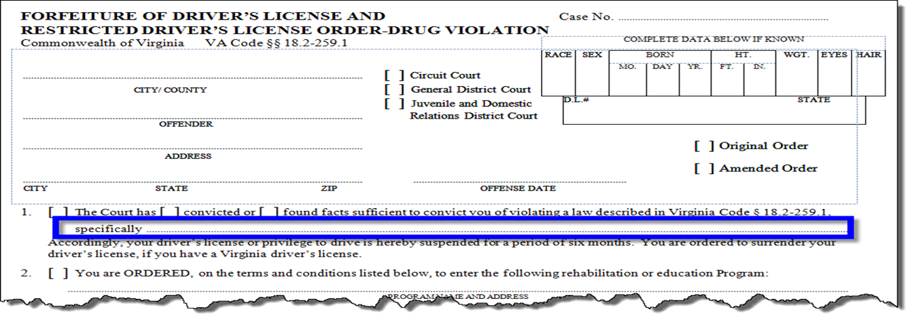
Restrictions for Drug Offenses
For the DC359, Forfeiture of Driver License and Restricted Driver’s License Order- Drug Violation
A space is provided for courts to populate the specific Code section in which the court convicted, which helps expedite updating a customer’s driving record and allow the issuance of the RDL.

Slide 15
ASAP Revoked vs Revoke Restricted License
Removal of Restricted Privileges
When the court orders the removal of restricted privileges or ignition interlock (i.e. during the revocation period for a DUI 1st conviction)
The privilege to drive for the remainder of the revocation period is terminated and the license status will display as “revoked”.
Complete driver’s license retesting is required to obtain a license.

Slide 16
ASAP Revoked vs Revoke Restricted License
ASAP Revoked
If a customer is convicted of DUI 1st or DUI 2nd, violates conditions of VASAP program and the court issues ASAP revoked order, Virginia Code §18.2-271.1(D) requires DMV to revoke driving privileges for an additional 12 months or 36 months respectively, beginning on the ASAP revoked date.

Slide 17
ASAP Revoked vs Revoke Restricted License
Language typically shown on court documents:
Found ASAP Non-Compliant, please update your records (additional information needed)
Removed from ASAP, unsuccessful (additional information needed)
Terminate from ASAP (DMV will ASAP revoke)
Revoked from the ASAP program (DMV will ASAP revoke)
Remove from ASAP, revoke restricted license (additional information needed)
Remove Interlock and revoke restricted license (DMV will terminate the restricted license order)
Please Note: All Amended abstracts must have an effective date

Slide 18
DMV Administrative Requirements
Deferred Drug Violations
If the court adjudicates a drug violation as a deferred disposition or finding under advisement, Virginia Code §46.2-390.1 mandates that DMV suspend the person’s driving privileges for 6 months. (Effective July 1, 2017 this will no longer apply to a charge of possession of marijuana §18.2-250.1)
If violation is later dismissed or vacated, yet the 6 month suspension time has been delayed due to another indefinite order(s) on the person’s record, DMV is still required to impose the 6 month suspension

Slide 19
DMV Contact Information
Conviction and Suspension Processing
Manager – David Showers
804- 423-1720
Fax: 804-367-2027 or 804-367-0666
Driver’s License Compliance
Manager - Jacquelyn Mines
804- 423- 1733
Fax: 804-367-6211 or 804-367-6694

Slide 20
Questions?

Slide 21
THANK YOU
Florence Jett
Florence.Jett@dmv.virginia.gov
(804) 497-7137

